Slide 1
Managing Large-Scale Database Migrations
Govern, Mobilize & Scale

Slide 2
Agenda
The purpose of this document is to define the program management, governance and staffing challenges customers face when migrating hundreds of on-prem commercial databases to AWS database services.
This governance model will define the tools to organize the database migration pipeline, prioritize migrations, manage staffing models, and track status information from many parallel teams to provide senior leadership with visibility on performance metrics by building program level dashboards.
We will define the methods and resources needed to manage, govern and staff multiple database migration factories to enable customers to refactor, replatform and rehost databases at scale.
We will also discuss the use of AWS tools and services such as the Database Assessment Framework (DMAF) for estimating effort and Database Migration Accelerator (DMA) as a migration factory for qualifying workloads.

Slide 3



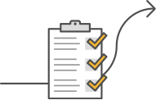





Database Migration Customer Journey
ASSESSMENT
READINESS & PLANNING
DATABASE MIGRATIONS
Assess Databases
Establish Governance & Program Management
Migrate Databases At-Scale
Proserve / GCC
Rapid
Discovery
Define
Governance
Build Core
DB Team
Education &
Training
Building a
DB Pipeline
Estimate Effort
(DMAF)
DMA Factory
Directional
Business Case
Engaging Migration
Teams (DMA,
Partners, GCC)
Building
Migration
Dashboards
Define Migration Metrics
Pilot
Migrations
Partner Teams
Customer Teams

Slide 4
Governance

Slide 5
Define Governance
Mission Statement: . To establish governance model on a large-scale database we start with a Program Level leadership team which is composed of a combination of local and global leads whose responsibilities are to manage the pipeline of new databases, decide on migration strategies, and act as the primary point of contact for the customer’s core engineering team and program leads.
As databases move through the factory pipeline towards migration, we stand-up parallel one-time Migration teams which are staffed to either refactor one large database or several smaller databases utilizing the same technology stack. This gives us the flexibility to staff teams based on the skillsets required while also allowing many Migration teams to work in parallel as we scale up the work effort.
The Migration teams report up their progress and issues using factory dashboards to keep the Program Level leadership team informed and allow for prompt escalation of issues.
Outcomes:
Define Governance Model
Establish Program Leadership Team

Slide 6
Large-Scale Database Migration Governance
Program Management
Executive Sponsorship
DB Discovery Team
Refactor Team
Rehost Replatform Team
Education & Training
Workload Qualification
Migration Strategy
Estimate Effort
QA/Go-Live Support Team
Proserve/GCC
DMA Factory
Partner Teams
Customer Teams
Partner Teams
Customer Teams
Proserve
Partner Teams
Customer Teams
Database Pipeline
Dashboard & Metrics

Slide 7
Core DB Cloud Team

Slide 8
Define Core DB Cloud Team
Mission Statement: The Customer will define a Core Database Cloud team who will act as primary point of contact for the AWS Program leadership team to set overall program priorities, align other customer teams, maintain a pipeline of databases to be migrated, and establish technical standards to be applied across the enterprise. The Core Database Cloud team will contain a combination of Database Engineering Leads, Infrastructure, Security, and Application Development, and Program Management resources.
Objective:
Establish Customer Database Cloud Leader
Liaison with other Customer Teams
Manage Pipeline of Databases
Establish Technical Standards
Train & Enable Customer Teams
Outcomes:
Customer Core Database Cloud Team Defined
Leader and Resources Assigned
Architecture Review Board Established
Database Cloud Leader
Database Engineers
Cloud Architects
Training Specialist
Program Management
App Dev

Slide 9






Database Cloud Center of Excellence
Database Cloud Leadership Team
Database Cloud Business Office
Business & Governance
People
Architecture
Review Board
Program
Management
Project
Management
Financial Management
Migration
Experience
Training
Cloud Platform Engineering
9
Platform
Operations
Security
Codified
Patterns
Build, Test, & Deploy
Define
& Enforce
Core
Platform
Operate
& Manage
Detect
& Respond
Database Cloud Operations
Security Operations

Slide 10
Education & Training

Slide 11
Education & Training
Mission Statement: Education and Training is critical to establishing a customer’s database migration readiness. A training plan should enable the customer teams with a broad understanding of AWS database services (e.g. RDS, Aurora, DynamoDB) and key AWS database migration tools such as SCT and DMS.
Objective:
Build a training plan for the migration team
Establish an understanding of AWS database services
Understand the benefits trade-offs in re-hosting, re-platforming,
and refactoring databases.
Get experience using AWS database migration tools
Outcomes:
Trained Core Database Cloud Team
Broader understanding of AWS Database Services
Customer teams meet their AWS certification goals.

Slide 12
Database Pipeline

Slide 13
Building a Database Pipeline
Mission Statement: After conducting discovery on the customer databases available to be migrated and utilizing tools such as DMAF to conduct an assessment, the leadership team will need to maintain an active pipeline of databases to be migrated. The prioritization of this pipeline may be based on a combination of technical factors (source platform, target platform, level of effort) and business factors (business criticality, subject matter expert availability, budget constraints). The database pipeline can be expected to vary overtime on a large migration reflecting changing business priorities.
Objective:
Establish Visibility on Databases available to be migrated
Track Estimated Level of Effort
Consider Expected Benefit
Reflect Business Constraints
Set Priorities
Build Migration Waves
Outcomes:
Maintain an active Pipeline of Databases to be Migrated
Migration Wave Plans

Slide 14
Database Wave Planning
Review and Validate Database Inventory
Review and Validate Application Inventory
Determine Migration Path
Retain / Rehost / Refactor / Rearchitect / Retire
Identify Target AWS Database
Determine Application Dependencies on DB and Application interdependencies
Estimate Migration Effort (App/DB)
Determine Migration Waves
Determine Migration Priority based on Business Value, Migration Risks, Complexity/Effort
Create Migration Waves Roadmap

Slide 15
Sample Database Backlog

Slide 16
Engaging Migration Teams

Slide 17
Engaging Migration Teams
Mission Statement: To scale up a Database Migration program to migrate hundreds of databases, we will scale-up to multiple migration teams executing in parallel. These teams can be staffed from AWS Proserve, from AWS Proserve’s Global Competency Center (GCC), AWS Partners, or from Customer teams. In addition to building teams, we can also leverage the AWS DMA migration factory service to migrate some of the databases.
Each approach offers different trade-offs and can be used in various combinations to optimize the benefits for each set of databases. For example, GCC may offer economic advantages, DMA may require less overhead, Partner teams may have specialized industry expertise, and Customer Teams may have institutional knowledge of legacy systems.
Objective:
Decide whether to utilize GCC and/or DMA
Identify Partner teams to engage
Engage with Customer teams
Stand-up multiple Migration Teams
Outcomes:
Migration Partners Defined (GCC, DMA, Partners)
Migration Teams Established

Slide 18
Migration Dashboards

Slide 19
Migration Program Dashboards
Mission Statement: In order to manage several migration teams executing in parallel, we establish a well orchestrated, loosely coupled mechanism by building Migration Program Dashboard and defining Migration Metrics. The program dashboards can used to track the work of each migration team and then roll-up the status into a program level dashboard
Objective:
Track the progress of database migrations through key milestones
Escalate blocking issues to program leadership
Manage resource assignments for each migration team
Establish visibility on resource availability to plan future waves
Provide visibility of overall program status to senior leadership
Outcomes:
Overall Migration Program Dashboard
Migration Factory Team Detailed Dashboard
Migration Factory Team Resource Plan
Migration Factory Resource Assignments

Slide 20
Sample Overall Status Dashboard
 | The overall engagement status is currently Yellow due to our Velocity Metrics.
Database Conversions
 | We completed conversion of DB13 and handed-over for Customer team to convert Business Logic. We have completed conversion and conducted hand-over ceremonies for DB16, DB17, and DB18.
Database Testing & Go-Lives
 | There are now three databases remaining from Waves 2 & 3 to complete testing. DB5 is targeting end of June to go-live. DB6 go-live is still TBD. DB7 is targeting July. DB9 & DB10 are preparing to start end-to-end testing. DB 3 is live in Prod.
Database Pipeline
 | There are currently databases in the pipeline to keep the team engaged through July. Customer is working to firm-up remaining pipeline for 2021.
Velocity Metrics
 | At our current velocity, we are at risk to not hit our current target of databases by the end of Year 1. This is due primarily to larger average effort required to refactor database and app code.
Resources
 | The AWS team is currently staffed at 21 resources. Given current databases, we are now seeing less demand for App Dev resources.
Budget
 | As of June 4, 2021: Billable Budget Burned: $XXX (25%) Adoption Incentive Burned:$XXX (24%)

Slide 21
Migration Factory Dashboard Details

Slide 22
Migration Factory Dashboard Details (cont’d)

Slide 23
Proserve/GCC Resource Assignments

Slide 24
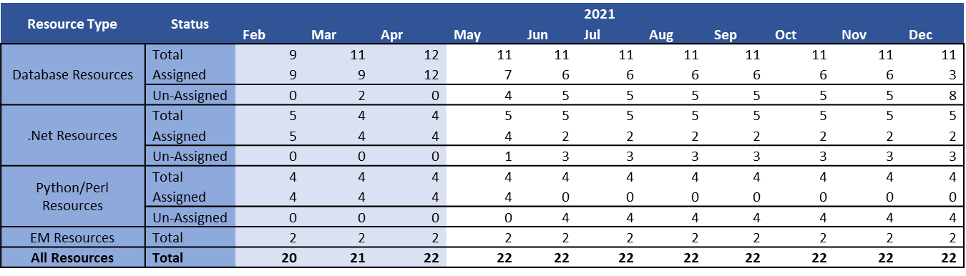
Proserve/GCC Resource Plan

Slide 25
Migration Metrics

Slide 26
Define Migration Metrics
Mission Statement: To provide an objective measure of the progress of the overall Migration program, we define program-level metrics to be tracked for each migration team or for the entire program. The migration metrics can be used to identify problems early on by tracking each key set of milestones versus a target velocity.
Objective:
Databases Started Each Period vs Target Metric
Databases Refactored Each Period vs Target Metric
Databases UAT Tested by Customer Each Period vs Target Metric
Databases Released to Production Each Period vs Target Metric
Resources Allocated vs Target Metric
Budget Burned vs Target Metrics
Outcomes:
Define Key Success Metrics
Program Level Dashboard

Slide 27
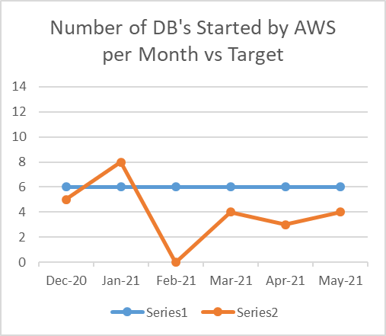
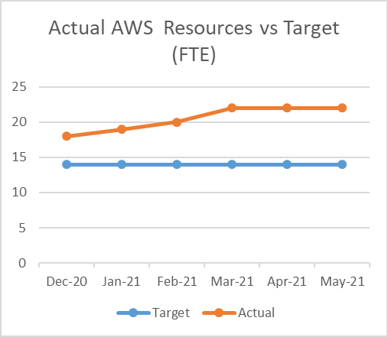
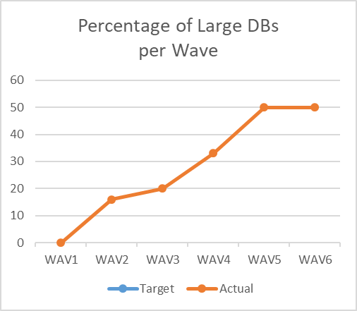
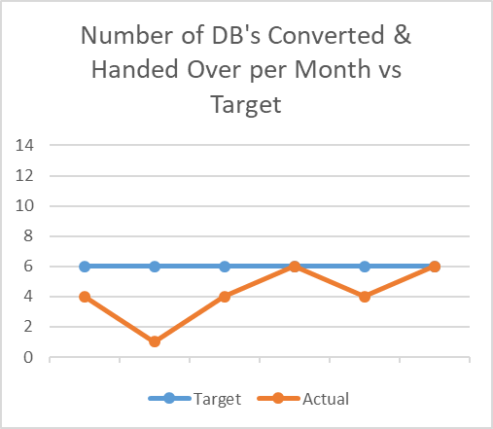
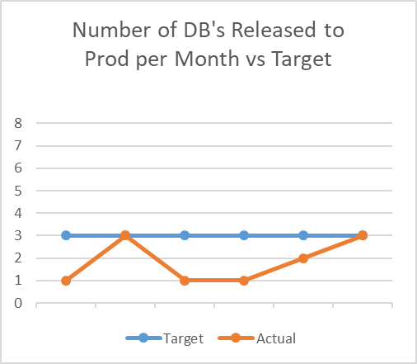
Sample Metrics
Inputs
Outputs

Slide 28
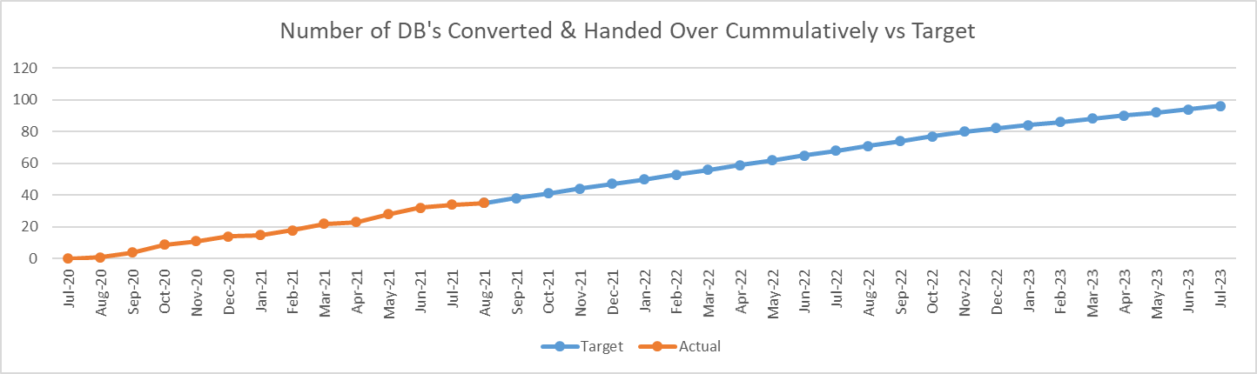
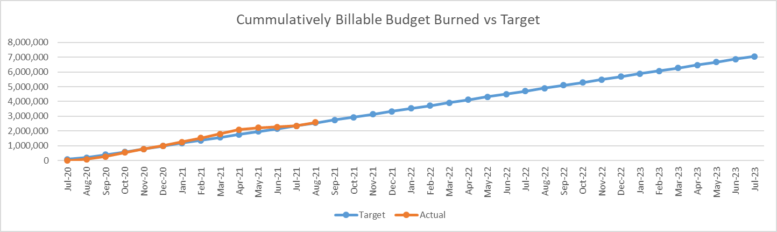
Sample Metrics
DBs
Budget

Slide 29
Pilot Migration

Slide 30
Pilot Migrations
Mission Statement: In order to ensure a smooth ramping up of migration teams, we start with a smaller wave of pilot migrations to get the core team hands-on experience migrating a database before we scale-up to multiple teams running in parallel. By starting with a smaller pilot, we give the team time to norm and refine the migration process before scaling up further.
Objective:
Identify up to ten databases for an initial Pilot
Give the core team hands-on experience
Ensure the migration process runs smoothly before scaling
Optimize the migration process based on lessons learned
Seed additional migration teams with experienced resources
Outcomes:
Up to ten pilot databases migrated
Core team trained with hand-on experience
Refined Migration Approach

Slide 31
Migration Pilot Steps
Application and DB Assessment
Create Wave Backlog
Wave Plan
Access to Source and Provision Target
Database Schema Conversion
Application Code Conversion
Data Migration
Functional Testing (UAT)
Performance Testing
Production Cutover
Transition
Documentation

Slide 32
Summary of Outcomes

Slide 33
Database Migration Readiness & Planning Outcomes
Governance:
Define Governance Model
Establish Program Leadership Team
Core DB Cloud Team:
Customer Core Database Cloud Team Defined
Leader and Resources Assigned
Architecture Review Board Established
Education & Training:
Trained Core Database Cloud Team
Broader understanding of AWS Database Services
Customer teams meet their AWS certification goals.
Database Pipeline:
Maintain an active Pipeline of Databases to be Migrated
Migration Wave Plans
Migration Teams:
Migration Partners Defined (GCC, DMA, Partners)
Migration Teams Established
Migration Dashboards:
Overall Migration Program Dashboard
Migration Factory Team Detailed Dashboard
Migration Factory Team Resource Plan
Migration Factory Resource Assignments
Migration Metrics:
Define Key Success Metrics
Program Level Dashboard
Pilot Migrations
Up to ten pilot databases migrated
Core team trained with hand-on experience
Refined Migration Approach

Slide 34
Start Mass Database Migrations…
Database Pipeline
Dashboard & Metrics
Program Leadership
Discover
Discover
Discover
Discover
Cutover
Design
Cutover
Design
Cutover
Design
Cutover
Design
Validate
Operating
Model
Build
Validate
Operating
Model
Build
Validate
Operating
Model
Build
Validate
Operating
Model
Build
Integrate
Integrate
Integrate
Integrate
Proserve / GCC
DMA
Partner Teams
Customer Teams

